Slide 1

Spotted Python
Week 4 Tutorial
Simple Graphing
For and While loops
Creating subplots

Slide 2

Simple Graphing
Matplotlib is the most used tool for visualisation
Documentation: https://matplotlib.org/stable/
List of in-built colours: https://matplotlib.org/stable/gallery/color/named_colors.html
List of in-built colourmaps: https://matplotlib.org/stable/users/explain/colors/colormaps.html
Module to import alternative colourmaps:
https://cmasher.readthedocs.io/index.html
Tool to create colourmap: https://gka.github.io/palettes

Slide 3
For and While Loops
For loops repeat a piece of code while changing an input variable
While loops repeat a piece a code until a certain condition is met
Complete Exercise 1

Slide 4
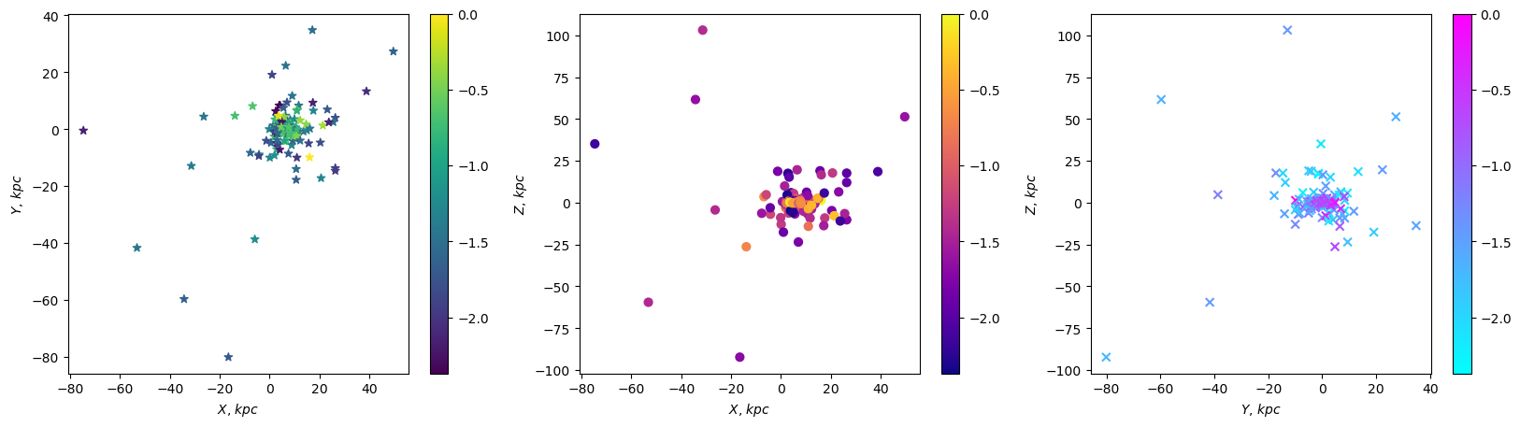
Milky Way Globular Clusters
Reminder that the assignment data can be found under assessment hub → computational assessment data
For the working example, use the harris_combined.csv provided
Colouring the GC by [Fe/H], what trends do we see?

Slide 5
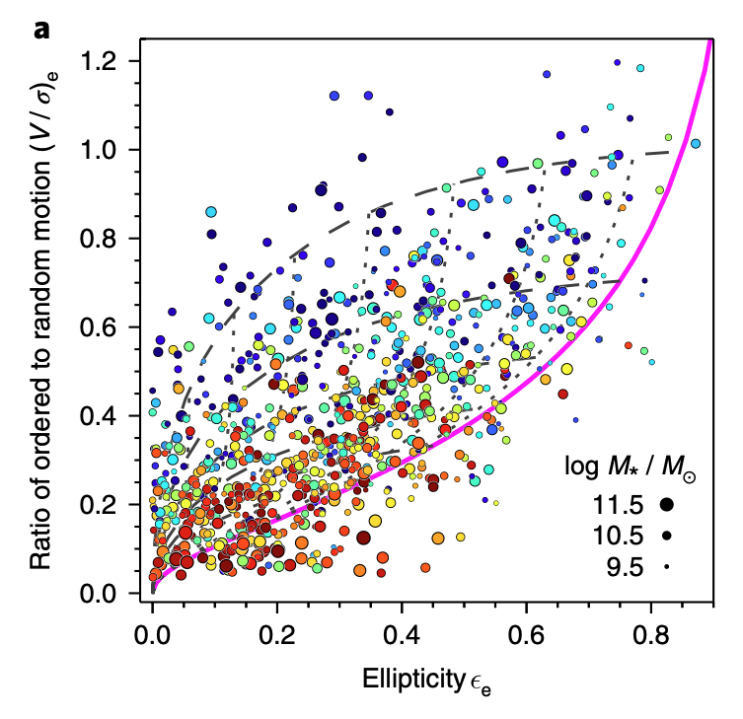

SAMI
Relationship between $V/σ$ and $ε$ (Cappellari, 2007)
$${\left(\frac{V}{σ}\right)}_{e}=\sqrt{\frac{\left(0.09+0.1ε\right)ε}{1−ε}}$$
Try to recreate this figure from van de Sande, 2017 (Exercise 2)

